Slide 1
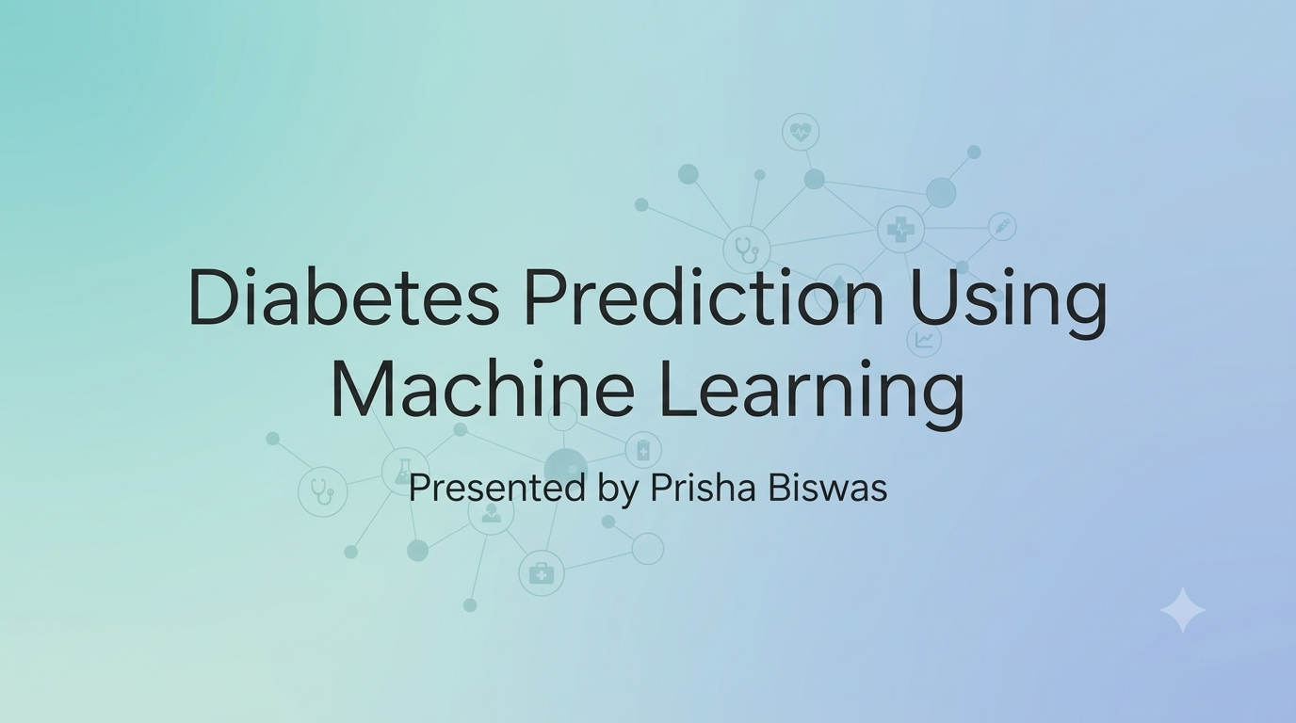

Slide 2



MACHINE LEARNING IN HEALTHCARE
Early Diabetes Risk Prediction System
An analytical framework leveraging clinical parameters for non-invasive early onset classification.

Slide 3



OVERVIEW
Summary
The Challenge
The Solution
Key Impact
Undiagnosed diabetes affects millions globally, leading to severe microvascular complications prior to clinical intervention.
Predictive machine learning models trained on routine clinical markers enable rapid, non-invasive risk screening.
Achieved high predictive accuracy, establishing optimal trade-offs between precision recall and diagnostic interpretation.

Slide 4
CONTEXT & CHALLENGES
Problem Statement
Delayed Diagnosis: Asymptomatic early stages prevent timely metabolic interventions.
Resource Constraints: Frequent laboratory blood testing is expensive and inaccessible in remote regions.
Early detection can reduce long-term diabetic complications by up to 40%.
Complex Multivariable Patterns: Nonlinear dependencies between BMI, age, and glucose complicate manual diagnosis.
— Global Healthcare Clinical Standard

Slide 5
GOALS
Project Objectives
1
Automated Risk Screening
2
Feature Significance
Develop a predictive pipeline using standardized clinical measurements to estimate onset risk.
Identify primary physiological drivers influencing diabetes classification performance.
3
Model Benchmarking
4
Clinical Deployment
Compare linear, ensemble, and distance-based classifiers to pinpoint optimal metrics.
Deliver an interpretable framework suitable for integration into preliminary care workflows.

Slide 6
DATA SOURCE
PIMA Indians Dataset Overview
768
8
268 / 500
Total Patient Records
Clinical Features
Positive / Negative Ratio
Target Population: Females at least 21 years of age of Pima Indian heritage.
Target Variable: Binary Class Outcome (0: Non-Diabetic, 1: Diabetic).

Slide 7
DATA SPECIFICATION
Clinical Variables Breakdown
Feature Name | Description | Type | Medical Relevance
Glucose | Plasma glucose concentration (2-hr test) | Numeric | Direct indicator of glycemic control
BMI | Body mass index (weight in kg/(height in m)²) | Numeric | Adiposity linked to insulin resistance
Age | Age in years | Numeric | Risk scales with biological aging
Pedigree Function | Diabetes hereditary history score | Numeric | Genetic susceptibility factor
Insulin / BP / Skin | 2-Hour serum insulin, Blood Pressure, Skin Fold | Numeric | Secondary metabolic markers

Slide 8
WORKFLOW
Methodology Pipeline
1. Ingestion
2. Cleaning
3. Scaling
4. Modeling
Raw PIMA dataset loading & validation.
Median imputation for invalid zero values.
Standardization (Z-score normalization).
Classifier training & 70/30 train-test split.

Slide 9
ALGORITHMS
Model Architecture Comparison
Logistic Regression
Random Forest
K-Nearest Neighbors
Baseline linear model providing high interpretability and probabilistic log-odds estimates.
Ensemble decision trees capturing non-linear feature interactions with reduced variance.
Distance-based instance classification evaluating localized patient parameter clusters.

Slide 10
IMPLEMENTATION
Training & Validation Strategy
Train-Test Split: 70% training set (537 samples) and 30% testing set (231 samples).
Primary Evaluation Metrics
Cross-Validation: 10-fold CV applied during hyperparameter tuning to prevent overfitting.
Accuracy
Overall Correctness
Recall (Sensitivity)
True Positive Identification
Optimization: Grid search for optimal K-neighbors and Random Forest tree depths.
ROC-AUC Score
Class Separation Ability

Slide 11
EVALUATION
Experimental Performance Results
Model | Accuracy | Recall | AUC Score
Random Forest | 78.5% | 71.2% | 0.83
Logistic Regression | 76.2% | 65.8% | 0.81
KNN (K=5) | 74.8% | 62.1% | 0.78
Key Findings
Random Forest demonstrated superior overall performance due to its resilience against missing attribute noise and non-linear feature interactions.

Slide 12
INSIGHTS
Key Physiological Predictors
Glucose Concentration
34% Importance
BMI (Body Mass Index)
22% Importance
Age
16% Importance
Diabetes Pedigree Function
12% Importance

Slide 13
CONCLUSION
Early Machine Learning Interventions Improve Patient Outcomes
By automating clinical risk assessment with models like Random Forest, early screening becomes accessible, non-invasive, and highly accurate.

